Slide 1

SAMA Annual Meeting
January 4, 2026
11:00 a.m. EST Google Meets

Slide 2

Agenda
2025 in Retrospect
2025 Financials
2026 Plan/Objectives
Discussion

Slide 3


Welcome & Introductions - Ivan
WELCOME REMARKS
INTRODUCTION OF NEW BOARD MEMBERS, STAFF, OR VOLUNTEERS

Slide 4
Review of Mission and Vision
Reaffirm the nonprofit’s mission, vision, and values
Discuss any updates or refinements to mission or vision
Discuss update or refinements to the board

Slide 5
Year in Review – 2025: Zoran/Daniel
Financial Overview - Zoran
  Presentation of financial statements and funding sources
  Budget vs. actual comparison and key financial highlights
Program and Impact Updates - Daniel
  Summary of key programs and services delivered over the past year
  Impact and outcomes – successes, challenges, and lessons learned
Fundraising and Development - Zoran
  Review of fundraising efforts, events, and donor contributions
  Success stories and challenges faced in fundraising
Scorecard Reporting - Daniel

Slide 6
2025 in Retrospect:
Positive
  Finished renovations of 4 Health Stations as committed in 2024
    HS Ušće - HC Kraljevo
    HS Belušić - HC Rekovac
    HS Rabrovo - HC Kučevo
    HS Aleksandrovo - HC Srpska Crnja
  HS Stapari – finished renovation of this HS with funds collected at Chicago Fundraiser by Branko!
Negative
  Failed on project executions for Loznica and Bogatić
    Poor project identification – need to apply more scrutiny for future projects that we accept
    It is getting a lot harder to execute projects in Serbia with transparency/integrity
  Have $100k+ in the bank that we failed to invest in projects!
  Failure to get video on Vršac project!
To be discussed
  Our overhead was significantly higher than previous years
    Major reason is investment in video for Ušće project and in communications – what can we show for it?

Slide 7
2025 SAMA Top Level Financials
Bank Account | Balance
Beginning Balance (across all accounts) (1/31/2025) | $172,861.80
Total funds raised | $184,487.00
Total funds spent on projects | ($235,146.96)
Total funds spent on overhead | ($15,064.35)
End Balance (across all accounts) (12/31/2025) | $107,137.49
https://serbianama.info/2025-financial-report/

Slide 8
2025 Balance by Account
Bank Account | Balance 1/1/25 | Balance 12/31/25
Balance BofA Account | $169,970.13 | $92,564.72
Balance Paypal Account | $1,807.90 | $2,898.64
Balance Serbia RSD Account | $1,083.77 | $3,174.13
Balance Serbia USD Account | $0.00 | $8,500.00
Total | $172,861.80 | $107,137.49
https://serbianama.info/2025-financial-report/

Slide 9
2025 Fundraising Activities
General Donations | $35,659.90
SAMA Tennis Open - Washington | $11,410.00
SAMA Tennis Open - Chicago | $20,770.00
Chicago Fundraiser 2025 (Stapari Health Station) | $85,250.00
Holiday Fundraiser | $7,085.65
Aksentijevich Slava | $7,500.00
SAMA Operations Fund | $12,091.45
Other (Slavas, In memory of David Vuich etc) | $4,720.00
Total | $184,487.00
https://serbianama.info/2025-financial-report/

Slide 10
2025 Projects
Name | Country | Project | Cost
HC Kraljevo | Serbia | Renovation of Health Station in Ušće Installing new lowered ceiling (~320m2) with insulation (~10cm), install 40 new lights, replace windows (various dimensions, total of 19) and doors (total of 21), prepare and paint ceilings (~320m2) and walls (~600m2), prepare and install new PVC flooring (~320m2), replace all horizontal and vertical gutters, new façade (~278m2) | $89,884.29
HC Rekovac | Serbia | Renovation of Health Station in Belušić Installing new lowered ceilings (~273m2), 27 new ceiling lights, preparation and painting ceiling and walls (~300m2) | $15,091.41
HC Srpska Crnja | Serbia | Renovation of Health Station in Aleksandrovo Replacing doors (total 14) and windows (total 9), fixing and painting walls around windows and doors, fixing staircase in front of the entrance (20m2 ceramics), new reception desk | $22,596.71
HC Kučevo | Serbia | Renovation of Health Station in Rabrovo Replacing windows (various dimensions, total 16), replacing door (1), fixing and painting walls around windows and doors | $11,214.53
HC Užice | Serbia | Renovation of Health Station in Stapari Complete reconstruction of water and electric installations, roof reconstruction (~145m2), install new gutters (~70m), new façade (~100m2), replace windows (various dimensions, total of 4) and doors (9), replace entrance door, install new lights (10) and radiators (6), renovate toilets (~40m2 ceramics, 2 toilet, 5 sinks, 1 hot water boiler), new ceramic floor (~56m2), lowered ceiling (80m2), paint walls and ceilings (~220m2), new fence around the yard, new medical furniture | $87,084.67
Psychiatric Hospital Vršac | Serbia | Donation of 50 anti-decubitus mattresses with covers | $9,275.35
 |  |  | $235,146.96

Slide 11
2025 SAMA Overhead Spending
Paypal, Pledgelink, Benevity, Evite fees | $814.36
BofA Bank fees | $45.00
Subscriptions (Mailchimp, Zoom)* | $935.59
Web Maintenance* | $2,400.00
Marketing and Fundraising* | $6,653.01
State Fees (MD,IN,IL,WI)* | $701.00
RS Bank Fees* | $94.58
RS Admin Fees* | $220.81
Federal Tax Return* | $3,200.00
Total | $15,064.35
Video processing for Usce | $1,947.29
SAMA Tennis Open Insurance | $745.00
Communications Contractor | $3,000.00
Federal CFC Appl. | $314.00
Il Mana Advertising | $240.00
Other | $406.72
Total | $6,653.01
* Paid from SAMA Operations Fund
https://serbianama.info/2025-sponsored-expenses/

Slide 12
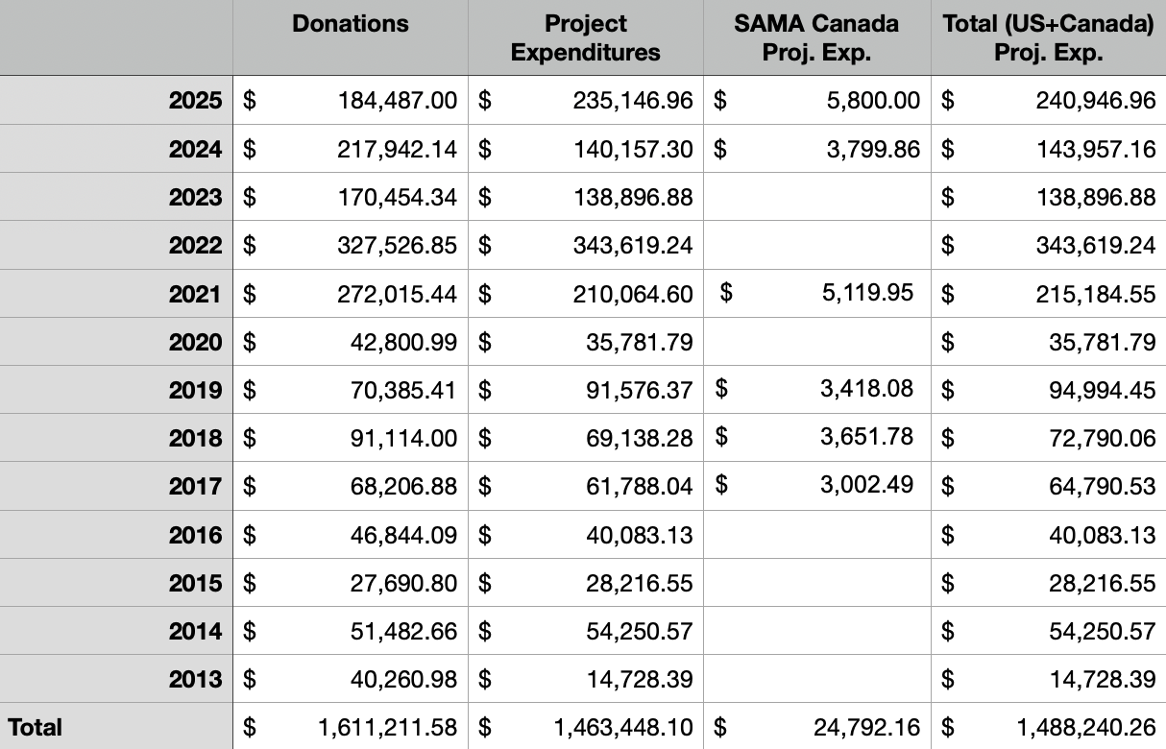
2013-2025 SAMA Donations

Slide 13
2026 Main Project Proposal:
Focus on helping baby delivery wards in Serbia
Plan
  Invitation to send donation requests – by Jan 31st (or Sveti Sava?)
  Review requests and decide what should be funded – by Mar 31st
  Decision communication – by Apr 15th
  Execution: Q2/Q3 2026
Budget
  $100k

Slide 14
2026 Short Term Projects:
HS Stapari
  Procure medical instruments for HS Stapari
    6ch ECG
    Small sterilizator
    Fridge
    Oftalmoscop
    Reflector
    Scale
  Cost: 761,340 RSD, roughly $7.7k
  Branko committed that he will cover all the cost
Hospital Leskovac - delivery ward
  Vein finder
  Cost: 507,264 RSD, roughly $5.1k
  Cost will be covered by donation of Natalija Odanović
Donation contracts will be done by mid Jan

Slide 15
Strategic Planning and Goals for the Coming Year – Daniel/Tanya
  Review of current strategic plan or goals

Slide 16
Strategic Planning and Goals for the Coming Year – Daniel/Tanya
  Discussion of new strategic priorities or shifts in focus
    Global – We have North America and Serbia, merge US and Canada Facebook pages?
    Tanya – Enter the list here
    Where should we enter the Company Match Program?

Slide 17
Strategic Planning and Goals for the Coming Year – Daniel/Tanya
  Setting goals for the upcoming year (programs, fundraising, partnerships, etc.)

Slide 18
Board and Staff Reports - Tanya
  Updates from board members, committees, or key staff
  Discussion of any major decisions, policies, or changes
  Volunteer and staff recognition

Slide 19
Challenges and Opportunities - Zoran
  Discuss key challenges the nonprofit is currently facing (financial, operational, etc.)
  Identify new opportunities for growth, collaboration, or funding – Daniel/Tanya
  Open discussion for feedback and ideas from attendees

Slide 20

Donor and Community Engagement
  Update on donor relations, new donor acquisition, and stewardship
    Company Match Project
  Opportunities for community engagement and partnerships
  Plans for upcoming events, campaigns, or collaborations

Slide 21
Fundraising Strategy Moving Forward
  Review of fundraising goals and strategies for the upcoming year

Slide 22
Fundraising Strategy Moving Forward
  Discussion on potential new revenue streams or fundraising events
    Kolo – Women’s Health
    Fashion Show – Women Health
    Redwood Dance Group – 200 Children – Targeting for Children’s Charity
    Canada Walk a Thon
    Wine or Spirit Tasting
    Tennis Event
    Topaz Event

Slide 23
Fundraising Strategy Moving Forward
  Volunteer and donor engagement strategies

Slide 24
Open Floor for Questions and Feedback
  Open discussion with attendees to ask questions or provide feedback
  Address any concerns or suggestions for improvement

Slide 25
Closing Remarks and Next Steps - Tanya
Recap of key takeaways from the meeting
Outline next steps and action items
Acknowledgments and gratitude to attendees

Slide 26
Adjournment
Formal adjournment of the meeting
Networking or informal conversation after the meeting (if applicable)

